Slide 1
How to Wow Donors with Qgiv's Confirmation Pages and Receipts
Thursday, May 21 | 2:00-2:30 p.m. EDT
Notes:
Hello, everyone! Welcome to today’s inside look at how you can use Qgiv’s confirmation pages and receipts to really make your donors feel amazing about the gift they just made to your organization. I know how busy you are, and I know you’re working on fundraising during a really strange time. Thank you so much for spending some time with me today—I know that’s a really big deal.

Slide 2
Learn to raise more online!
Qgiv is an online fundraising platform that makes it easy for nonprofits of all sizes to raise more money online.
We put special emphasis on building tools that make it easy for you to make your donors feel like superheroes. We’ve got solutions for every nonprofit, including year-round fundraising tools, text giving, peer-to-peer fundraising, and more.
Want to learn how to raise more money online? We’d love to show you!
Visit us at www.qgiv.com
Notes:
If you don’t know me, my name is Abby Jarvis and I’m part of the team over at Qgiv. We’re an online fundraising platform that focuses on helping nonprofits raise more money, and part of how we do that is through webinars like this one. Today, we’re going to look at some best practices and how you can apply them to our tools. I know many of you who are here today are Qgiv clients: if you have any questions about how you can apply what we look at today to your own Qgiv account, please let us know! Our support team will walk you through how to use these tools. If you’re NOT a Qgiv client, we can help you, too: if you want to know more about these tools, let me know and I’ll get you in touch with the right person.

Slide 3
We’re recording this webinar! We’ll send you a copy after the webinar is complete.
Feel free to ask questions! Use the chat box to the left to ask your questions: we’ll answer them in a Q&A section at the end of the presentation
Notes:
We are recording this webinar, and I’ll send you a link and some other resources tomorrow morning. So you will have this handy in case you want to revisit it later or if you want to share it with someone at your organization. And, finally, we are going to have some time for questions at the end of this presentation; if you have questions during this session, drop them in the questions box and I’ll answer as many as I can at the end of our time together.

Slide 4
Why Does This Matter?
Do confirmation pages and receipts really make a difference?
Notes:
Okay! Now that housekeeping is out of the way, it’s time to really dig into confirmation pages and receipts. First, though, I want to take a minute to look at why this actually matters and why you should spend some time updating your confirmation pages and receipts.

Slide 5
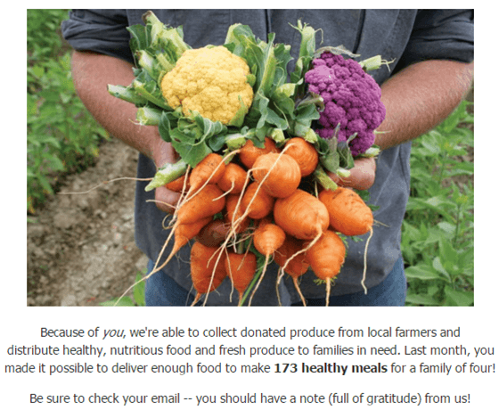
Donors Want These Assets!
Your confirmation page and your receipt are the first opportunities to communicate with your donors in the seconds after they give.
Take advantage of them to give donors what they want from you!
Donors want to be acknowledged
Donors want impact information
Donors want updates about their gift
Notes:
The big reason to update them, of course, is because they both represent valuable opportunities to give your donors what they want. These two assets are the first things your donor will receive from you after they make a gift, and they’re opportunities to capitalize on the good feelings your donors are experiencing in the moments after they give. Donors really want three things after they make a donation: they want to know how their gift is noticed and appreciated, they want to know how their gift is going to make a difference, and they want later updates about how their gift was used.

Slide 6
Let’s Expand on That for a Minute
Donors expect immediate acknowledgement
63.4% of donors want a receipt either immediately or within 24 hours of their gift
Donors want to know they made an impact
53% of donors want updates showing how their money was used
Communicating impact helps retain your donors
60.6% of donors have made long-term donations because they felt their money was used well
Notes:
And you don’t have to take my word for it! We recently did a study where we surveyed 1300 donors about their donation and communication preferences, and this is what we found. The donors we surveyed told us they want immediate acknowledgment of their gift, and they told us they look for updates about how their money was used. If those donors felt like their money was used wisely to make a real difference, they’re likely to continue giving. With a little customization, your confirmation pages and receipts can help you acknowledge their gift, communicate their impact, and set the stage for future updates that will help you retain your donors.

Slide 7
Let’s Explore How to Do That
Today, we’ll look at:
Elements to add to your donation confirmation pages
The formula for a delightful (and effective) donation receipt
How to use Qgiv’s tools to create confirmation pages and donation receipts that your donors will love
Notes:
So let’s look at how to do that. I’ll show you elements you can add to your donation confirmation pages that will make donors feel great about their gift. We’ll also look at how to build an outstanding donation receipt, and we’ll take a look at specific Qgiv tools you can use to put the best practices you’ll learn into action.

Slide 8
Confirmation Pages
Transform a boring transaction confirmation into a powerful thank-you
Notes:
The first thing your donor sees after they make a donation is your confirmation page. And yes, it’s totally the spot to show them their transaction details. But it can also be a way to start forging a relationship with the donor.

Slide 9
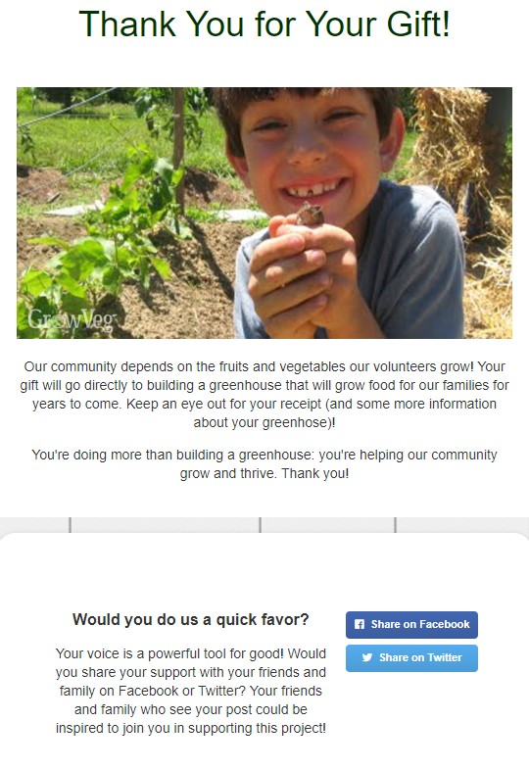
Elements of an Awesome Confirmation Page
Use this page to give donors what they want: acknowledgement, an impact statement, and hints at future updates
Image or video
Heartfelt thank-you message
Impact statement
Note about receipt
Next step(s)
Adding these few elements make a HUGE impact on your donors!
Notes:
Here’s an example of a great confirmation page and why it’s so awesome.
FIRST, look at this image: it gives me a look at exactly who my donation is helping. This is also a fantastic spot for a short thank-you video that shows donors more of who will benefit from their gift.
There’s also a really powerful thank-you message. It’s more than a simple “Thank you for your donation to our organization” message—it’s specific and it’s sincere. Donors love that.
Then there’s an impact statement. I want to point out a couple of things here: notice that the impact statement is specific (it doesn’t just say “you’re helping us do important work”) and it’s donor-centric. It doesn’t talk about the organization. Instead, it directly ties the donor to the community they’re helping with their gift.
Notice this sentence about the donor’s receipt! Telling a donor that they’re going to get a receipt and telling them that they’ll get more information about their gift’s impact is a great way to ensure donors actually open and read the receipt you send them. That’s going to be important, because, after this webinar, you’re going to start sending them super-cool receipts and you want them to pay attention to them!
I also want to draw attention to the social sharing buttons and the request for someone to share the form on social media. It may seem like a funny addition to a confirmation page, but there’s actually some science behind it.

Slide 10
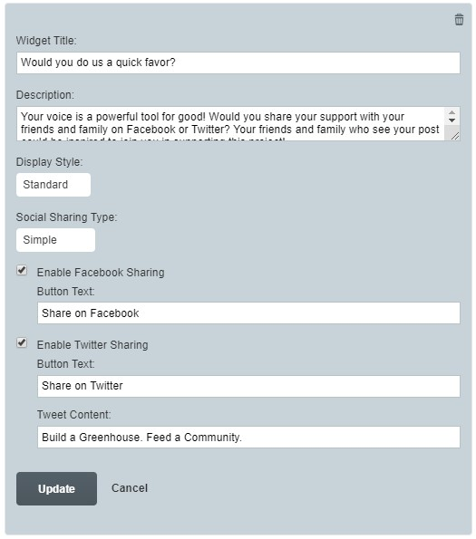
Life Hack:
Use the “Ben Franklin Effect” to engage your donors.
Ask your donors to do you a favor
Donors who “do a favor” for an organization have a more positive perception of the organization
Our brains tell us that we wouldn’t do a favor for someone we don’t like. If we did a favor for someone, we must really like them!
Make the favor easy, immediate, and non-financial
Notes:
You can use what’s called the Ben Franklin effect to connect with your donors. The Ben Franklin effect describes a specific psychological phenomenon that results when someone does a favor for someone else. If I do a favor for you, I’m more likely to do ANOTHER favor for you in the future. Psychologically, my brain thinks, “Oh, we did a favor for that organization. We must really like them! We’ll keep staying involved with them.” I’m more likely to stay engaged after doing you a favor than I would be if you did a favor for me instead.
Take advantage of this effect by asking your donors to do something for you after they give. The “favor” should be something really easy that doesn’t take long and doesn’t really require any investment on their part. Don’t ask for another gift! Instead, ask donors to share you form, or ask them to watch a video, or take a short donor survey. In their minds, they will have done something for you. They must really like you! And they’ll be more likely to stay engaged with you in the future.

Slide 11
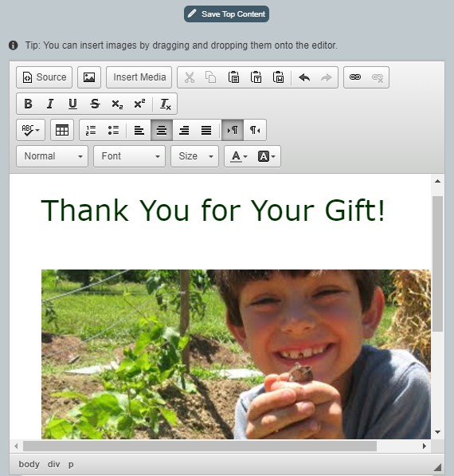
How to Do This in Qgiv
Everyone who uses Qgiv has the tools to customize their confirmation page. It’s part of your Form Builder!
Add images or embed a video
Add a great headline and impact language
Format text to match your branding
Include hyperlinks
Add a social sharing widget
Tweak theme settings
Add custom CSS
Notes:
You can add all those elements to your Qgiv confirmation page, and it’s actually really easy. The one I just showed you is actually a confirmation page I made in a few minutes, and TRUST me, you can do it if I can do it. To do this, you’ll open your form builder and switch the view over to the confirmation page. You can edit top and bottom content and the content in the body of the transaction details, too. Adding images or video is really simple, and you can format everything to match your organization’s brand. If you feel really fancy, you can also add custom CSS: we’ve seen some nonprofits get really creative with that tool. But custom CSS isn’t necessary: if you’re not a designer or a programmer, you can still make a really beautiful, high-impact confirmation page in just a few minutes.

Slide 12
Automated Receipts
Forget sterile receipts. Use this opportunity to delight your donors!
Notes:
After you’ve wowed your donors with a neat confirmation page, it’s time to zhuzh up your donation receipt. If you’re raising money online, your donors are probably already getting automated receipts generated by your fundraising platform. You might as well use them to your advantage, right?

Slide 13
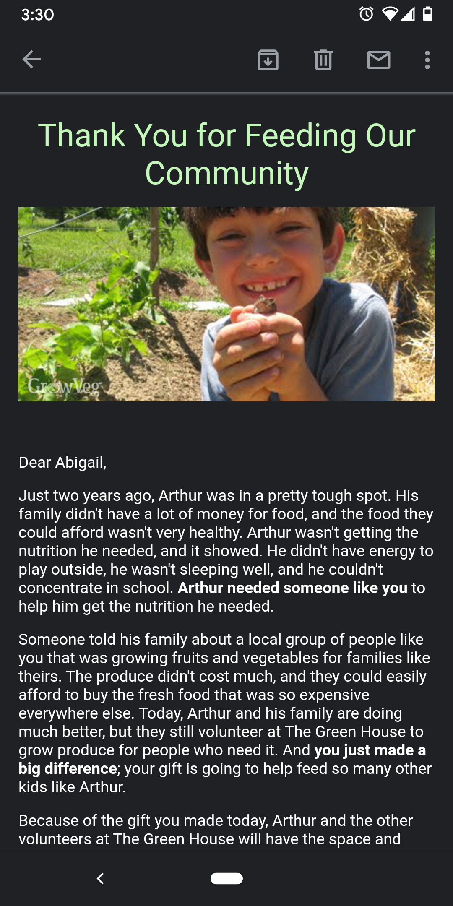
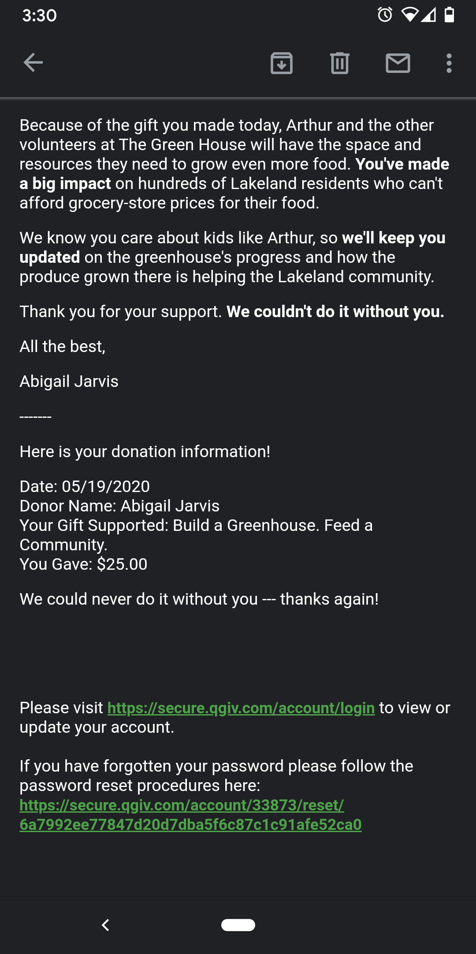
Knock Your Donors’ Socks Clean Off
Your donors did more than make a mere transaction—they made an investment in your cause! Send them a receipt that reflects that kind of investment.
Another fantastic image
Donor-centric language
Impact statement or story
Info about specific restriction/program or other details
Note about future updates
Transaction details
Notes:
One of my favorite things to do after I donate to an organization is see what they’ve done with their receipts. And I’ve seen some really great ones! But I mostly get receipts that are a lot like the ones I get when I order a pizza or buy a pair of pants online. Having those transaction details is nice, I suppose, but that kind of receipt represents a missed opportunity to get me really excited about the work you and I are doing TOGETHER to make a difference in the world.
That said, it’s REALLY easy to add a few elements to your donation receipt that will transform it from a boring transactional report to an outstanding way to inspire donors and set the stage for future interactions.

Slide 14
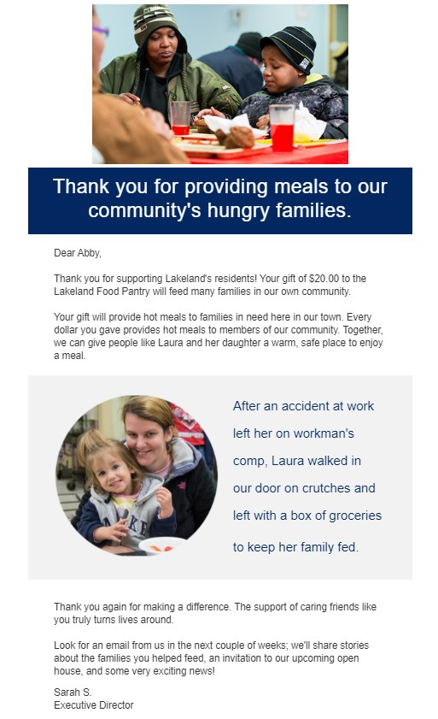
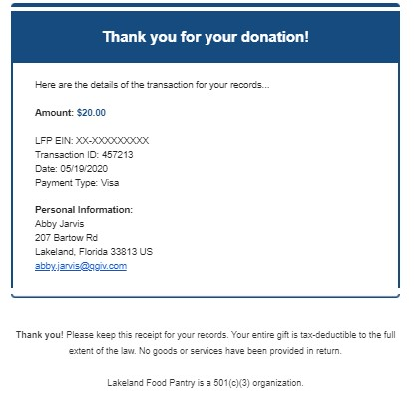
Knock Your Donors’ Socks Clean Off
Your donors did more than make a mere transaction—they made an investment in your cause! Send them a receipt that reflects that kind of investment.
Another fantastic image
Donor-centric language
Impact statement or story
Info about specific restriction/program or other details
Note about future updates
Transaction details
Notes:
Here’s the formula for that kind of receipt.
First, we want to include one or two really great images. You can use the same image you used on your confirmation page, which can establish some kind of continuity with your donor, or you can use different images. If you do decide to use different images, go with pictures that are still related to the program or cause your donor supported. If they gave to a program that feeds local families, it’d be weird for them to get a receipt full of images of your pet food pantry.
We know that donors love stories about the impact their gift will make, so make it a point to include details about the people they’ll help. Use donor-centric language here, too. Donors give to causes, not to organizations: if you can connect them directly to the work they’re doing, they’ll feel connected to your work and be more likely to support you again in the future.
Be as specific as possible about your donors’ gift. If they gave to your annual fund, talk about the broad goals they’re helping achieve. But if they gave to a specific program—in this case, a program that helps feed local families—give them details about that specific program. This helps donors feel “seen”—they see you sending them a receipt about the specific cause or program they supported, not just a generic receipt, and feel like their gift is actually important.
Remember when you included a note about the donor’s receipt on the confirmation page? You can do that here, too. Let donors know how they can get updates about their gift’s impact: tell them if you’re going to send a follow-up invitation, if you’ll call them, if you’ll update your social channels, whatever. They’ll be more likely to look for those updates and engage with them.
And then, of course, you’ll want to include your donor’s transaction details. It is still a receipt, it’s just a super awesome one!

Slide 15
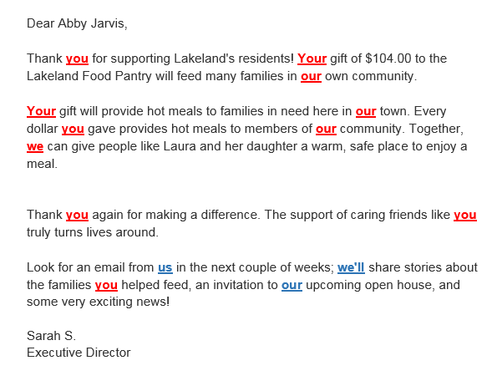
Life Hack:
Not sure your language is “donor centric” enough to convey how much your donors mean to you? Try using the Ahern Audit.
Circle “YOU” language in red
Circle “WE” language in blue
If “us” or “we” includes the donors, it’s red!
Your content should look like it has the measles!
FUN HINT: Using “you” in your subject line will get more people to read your receipt!
Notes:
Here’s one of my favorite life hacks of all time: if you have a hard time writing donor-centric content (and I think we all do, sometimes), here’s a tool you can use. It’s called the Ahern Audit, and it’s named after Tom Ahern, who is a fantastic fundraiser who’s written some of the best fundraising books I’ve ever come across.
The Ahern Audit is simple. First, write your content. Then, circle all “you” language in red. Words like “you,” “your,” get circled. If you use the words “we” or “our” and it includes the donor, that gets circled in red, too.
After that, you’ll circle all “we” language in blue. “We,” “us,” and your nonprofit’s name all get blue circles, and so do the words “our” or “we” if they DON’T include the donor.
Your circled words should mostly be red words. If you have more blue than red, re-write your content to place more emphasis on the donor.
This also works with subject lines, too! People are MUCH more likely to open and read emails that contain “you” language in the subject line!

Slide 16
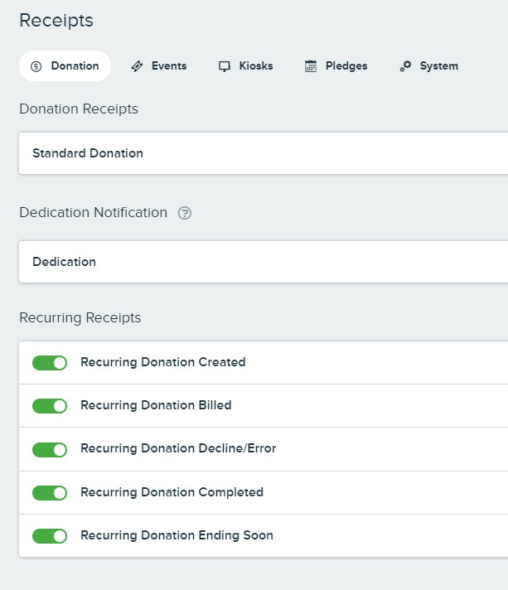
How to Do This in Qgiv
Everyone who uses Qgiv has the tools to set up multiple receipts for different occasions.
Regular donations
Recurring donations
Auction purchases
Event registrations or donations
Pledge creation and billing
Peer-to-peer donations, event registrations, and store purchases
And others!
Notes:
Now, Qgiv’s receipting system has a ton of tools available to make a great impression on your donors with your receipts. You can customize pretty every possible receipt. There are individual receipts for donations, peer-to-peer transactions, auctions, event registrations, and a series of special receipts for recurring donors. If a transaction can be processed through Qgiv, you can create a custom receipt for it.

Slide 17
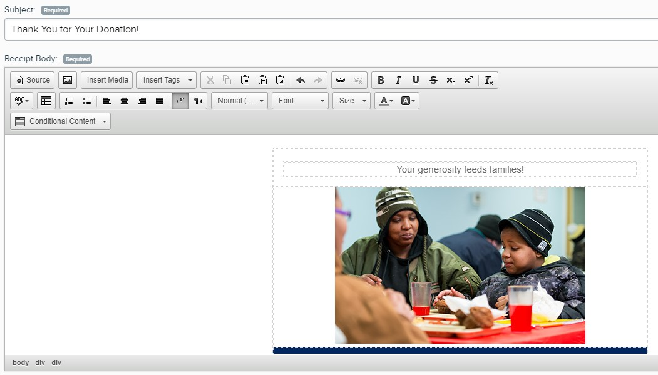
How to Do This in Qgiv
Each receipt is totally customizable!
Add images
Use tags to pull in specific info like your donor’s name and specifics about their gift
Different fonts, colors, and styling options means your branding can apply to receipts, too
Customize the “From Name” and reply-to address to make it feel extra-personal
Use your own subject line (and increase open rates!)
Attach .PDF receipts if needed
Notes:
The interface you’ll use to update your receipts is very straightforward. Like a word processor, you can use different fonts, colors, and styling to make your receipt match your brand. You can also use a tag system to pull in specifics of your donors’ gift and personalize the receipt a little bit: you can use those tags to pull in transaction details, their first and last names, honorifics, whatever you need.
One tool I really like is the ability to customize the names that will display in your donors inbox. People are more likely to open and interact with emails that appear to come from specific individuals instead of organizations; that’s why the email invitations you got to the webinar came from me, “Abby at Qgiv” instead of just “Qgiv” or “Qgiv Webinars” like I used to do.
You can also create your own subject line, which is important because we know subject lines have a huge impact on whether or not someone actually opens and reads an email. You can also add a .pdf receipt to the actual email, which is handy. If you’re in Canada, I believe attaching .pdf receipts to acknowledgement emails is actually required by law, so this is a handy tool if you’re up there. It’s also useful for, say, receipts for recurring emails. You could use the automated receipt to update your recurring donors on what’s going on with your organization and just include the transaction details in the .pdf, if that’s something you’re interested in trying.

Slide 18
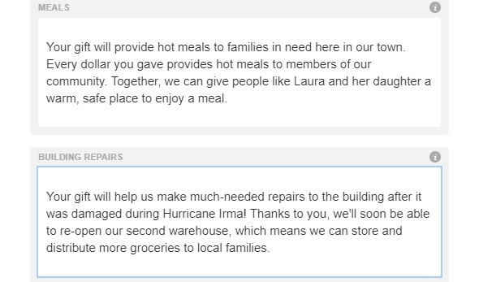
How to Do This in Qgiv
Make donors feel seen! Tailor language around your donor’s specific gift details using Conditional Content.
Include impact statements around specific restrictions or pledges
Call out donation dedications (in honor of, in memory of, etc.)
Acknowledge donors’ extra generosity if they use GiftAssist to offset fees
Celebrate donors’ follow-through if they complete a text pledge
Notes:
My very favorite feature in the receipting system is something called “conditional content.” We know that donors want to feel appreciated and want to know that their donation is recognized and valued, and this helps you do exactly that. Conditional content blocks contain content that appears in a donor’s receipt ONLY if they meet specific criteria.
You can add content blocks that will appear if a donor gives to, say, a specific program or fund, if they dedicate their donation to someone, if they offset processing fees—there are tons of applications. You can see in this screenshot here that I’ve built different content for people who gave to my “meals” restriction and my “building repairs” fund. This helps me be really specific when I tell the donor how their gift will make an impact! The donor who gave meals to my organization will get content specifically about that program, and the person who donated to repair our building will get information about what their gift will accomplish. Both donors will get personalized, specific information about what they’re accomplishing, and I can save time by not having to create individual receipts for every single program I help run.

Slide 19
How to Do This in Qgiv
Are you a Qgiv customer? Email support@qgiv.com
You have this level of control over all of your receipts, whether they’re going to a one-time donor on your year-round form, a bidder at your silent auction, or a team fundraiser at your peer-to-peer event.
Everyone who uses Qgiv can build unlimited donation forms, and each of them can have their own unique confirmation page!
Want to talk to us about using Qgiv? Email contactus@qgiv.com
Have questions about best practices? Check out qgiv.com/blog!
Notes:
You can apply that level of customization to all your receipts, so anyone who donates, registers for an event, or makes a purchase will get a receipt that makes them feel seen and appreciated and important. You can set up receipts and confirmation pages for individual forms, and anyone who uses Qgiv can make an unlimited number of forms! You can easily get really granular and specific with your donation forms and send even more personalized receipts and confirmation messaging.

Slide 20
One Quick Thing
From June 1, 2020 to the end of the year, you can get our data package at no cost. You’ll get unlimited access to:
Custom Reports
CRM & Email Integrations
Donor Summaries
Offline Donations and Registrations
Advanced Statistics (looks at 1 year of Qgiv transaction data)
You’ll also see some really exciting updates coming, including a brand-new form design!
Are you a Qgiv customer? Email support@qgiv.com
Want to talk to us about using Qgiv? Email contactus@qgiv.com
Have questions about best practices? Check out qgiv.com/blog!
Notes:
If you’re interested in seeing how all those forms compare to each other, we actually have something to help you. We’ve been hearing that many of our users are having to re-think a ton of the fundraising strategies they’ve used in the past, and being able to evaluate all possible data is a really important part of making sure you stay successful with everything that’s going on in the world. So, from the start of next month through the end of the year, all Qgiv users will have free access to our data plan. That will give you access to a few cool tools, including custom reports, integrations, offline gifts, and a few others. If you’re a Qgiv client and want to get that activated, email us at support@qgiv.com and we’ll get you set up. If you’re not a Qgiv user and are interested in learning more about those tools, you can get ahold of us at contactus@qgiv.com. We’ll answer all your questions and show you how those tools can work for you.
I’m also going to give y’all a little heads-up that there are some other cool things coming your way: the Qgiv team is working on some really exciting changes coming for Qgiv donation forms! They're getting a bit of a makeover we think you'll love. They’ll have a more modern aesthetic that’s designed to optimize the donation experience on both mobile and desktop, and they’ll have some conditional custom fields you that will help you streamline your donors’ giving process and make them feel even more seen and appreciated! There will also be other cool features like recurring upgrades, that I can’t wait for y’all to see—I got a preview from one of our designers last week and the new forms are going to be amazing. Keep an eye out for more details on those.

Slide 21
Questions?
Clients: support@qgiv.com
Inquiries: contactus@qgiv.com
Notes:
I know we covered a bunch of information in this webinar, so let’s dig into some of the questions you have about confirmation pages and receipts!

