Slide 1
Getting A Foot In The Door: How to successfully onboard new subscribers to your nonprofit enewsletter

Slide 2
Ephraim Gopin
Founder, 1832 Communications
Partner with nonprofits to build relationships and boost fundraising through smart and effective marketing
Proven track record of growing donor and user bases, increasing donations and building brand awareness

Slide 3
Live Tweeting
Please tag us:
@Qgiv
@EphraimGopin
Please add hashtag:
#QgivWebinar

Slide 4
What We’ll Be Learning
Strategy
Form location
The ask
Form fields
Donation form
Welcome email
Always be testing!

Slide 5
Coronaworld

Slide 6
Diversify Your Fundraising Portfolio
Multi-Channel Fundraising
Individual Donor
Corporate Partner
Legacy Giving
Foundation
Email Marketing
Events
Online Campaign

Slide 7
3 Stats To Know- And Take Advantage Of
4 billion
Statista
$37 billion
Blackbaud
40%
Qgiv

Slide 8
Email Marketing Strategy
4 things to consider:
The Rule of 7
You vs. We
Avg: Open 20.39%, CTR 2.66% (Campaign Monitor)
1 in 6 emails aren’t delivered (Validity)

Slide 9
Location, Location, Location

Slide 10
Location: The Dont’s

Slide 11
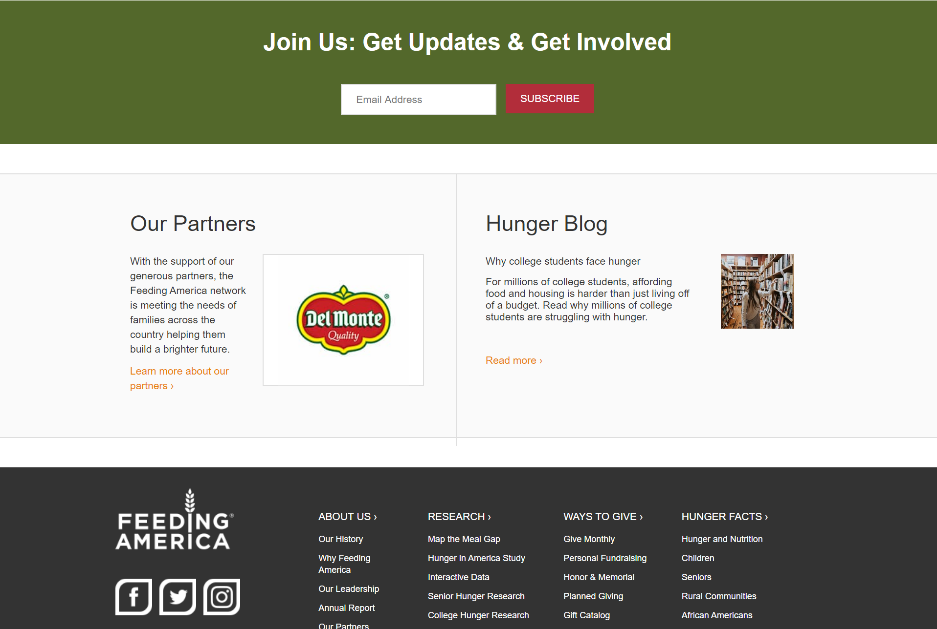
Location: The Do’s

Slide 12
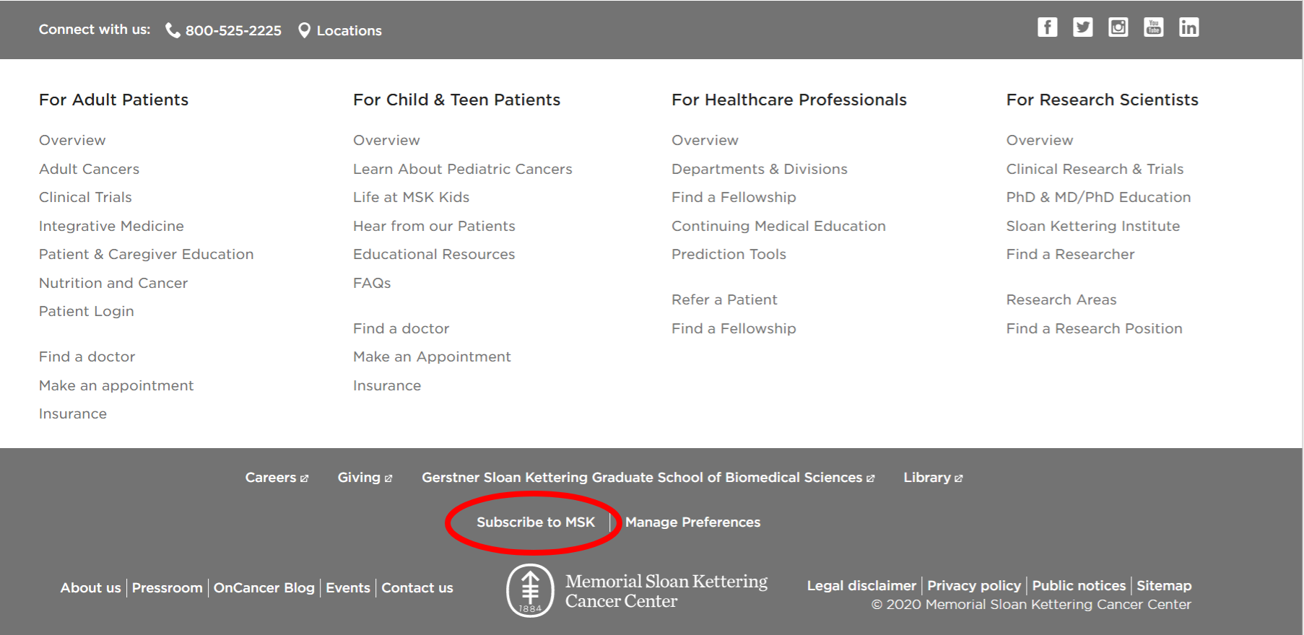
Location: The Dont’s

Slide 13
Location: The Dont’s

Slide 14
Location: The Do’s

Slide 15
Location: The Do’s But…

Slide 16
The Ask

Slide 17
The Ask: Show Value

Slide 18
The Ask: Active Subscribers!

Slide 19
The Ask: Who? What? How?

Slide 20
Form Fields

Slide 21
Form Fields: Expert Opinion

Slide 22
Form Fields

Slide 23
Form Fields No No: Part 1

Slide 24
Form Fields No No: Part 2

Slide 25
Form Fields 🤦‍♂️

Slide 26
Form Fields: Off To A Good Start

Slide 27
Form Fields: Not A Great Ending

Slide 28
Form Fields: Yes!

Slide 29
Donation Page: Expert Opinion

Slide 30
Donation Form: Opt-In

Slide 31
Donation Form: What?!

Slide 32
Bad Form

Slide 33
Bad Form

Slide 34
Gratitude Attitude

Slide 35
Gratitude Checklist
Immediacy
Mobile friendly
Good subject line
Sent by a person
Personalized
Easy on the eye
Warm and friendly
Set expectations

Slide 36
Expert Opinion

Slide 37
Gratitude Attitude: On Site

Slide 38
Gratitude Attitude: On Site

Slide 39
Gratitude Attitude: On Site

Slide 40
Gratitude Attitude: Welcome Email

Slide 41
Gratitude Attitude: Welcome Email

Slide 42
Gratitude Attitude: Welcome Email

Slide 43
Gratitude Attitude: Welcome Email

Slide 44
Gratitude Attitude: Welcome Email

Slide 45
No Thanks

Slide 46
No Thanks

Slide 47
No Thanks

Slide 48
Always Be Testing!

Slide 49
What To Test And Analyze
Form CTA
Subject line
Open rate and CTR
Content

Slide 50
Email Onboarding Checklist
Form location: Bottom, every page
The ask: Give me a reason!
Form fields: Email (and first name)
Donation page mention: Yes, opt-in
Gratitude: Pop-up message + welcome email
Always be testing!

Slide 52
Let’s Connect!
Website: 1832communications.com
LinkedIn: Ephraim Gopin
Twitter: @ephraimgopin
Daily NPO newsletter: /nonprofit-newsletter
Special offer: /QgivRocks
Have a question?
ephraim@1832comms.com

